Slide 1
https://twitter.com/nixcraft/status/847211858985500672

Slide 2
Improving code quality with Static Analyzers
https://github.com/jwooley/Analyzers

Slide 3




About Jim
Solultion Architect
Microsoft MVP
Slalom Consulting
Visual Studio Tools
03
Author
@JimWooley
LINQ in Action
https://jwooley.github.io
https://github.com/jwooley/Analyzers
http://www.thinqlinq.com
Notes:
Click the icon and navigate to your photo on your computer
Crop and position photo as desired
Go to the Arrange drop down menu > choose “send to back” to reveal text

Slide 4
Code Quality
Compile
Unit Test
Static Analysis
Peer Reviews
Trend Analysis
CI/CD
Style Guide

Slide 5
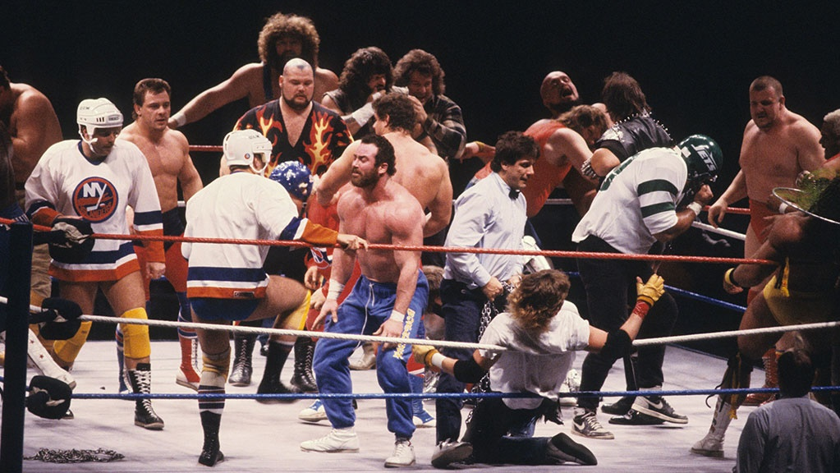

Slide 6

Interchangable team members

Slide 7


Slide 8
Code Quality
Compile
Unit Test
Static Analysis
Peer Reviews
Trend Analysis
CI/CD
Style Guide

Slide 9

“Static program analysis is the analysis of computer software that is performed without actually executing programs.”
Wikipedia
https://en.wikipedia.org/wiki/Static_program_analysis
slalom.com
Notes:
Quote Sample

Slide 10
Why use
Standardize within team
Improve maintainability
Allow code review to focus on domain/logic issues
Detect common errors not caught by compiler
Fix code smells

Slide 11
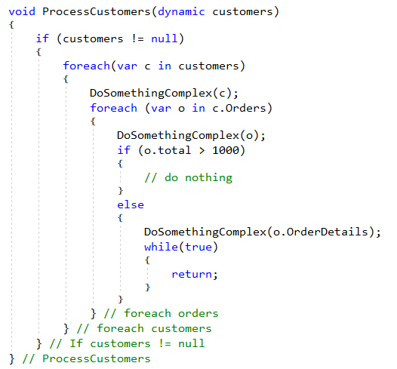
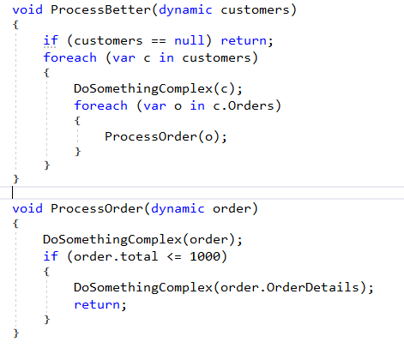
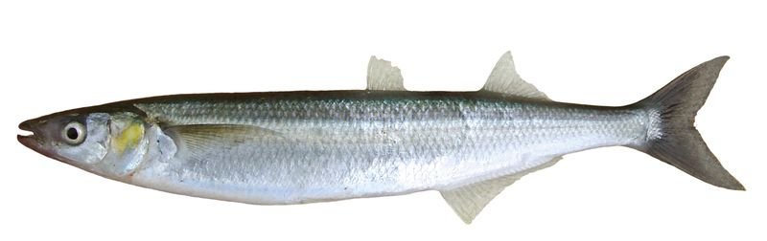
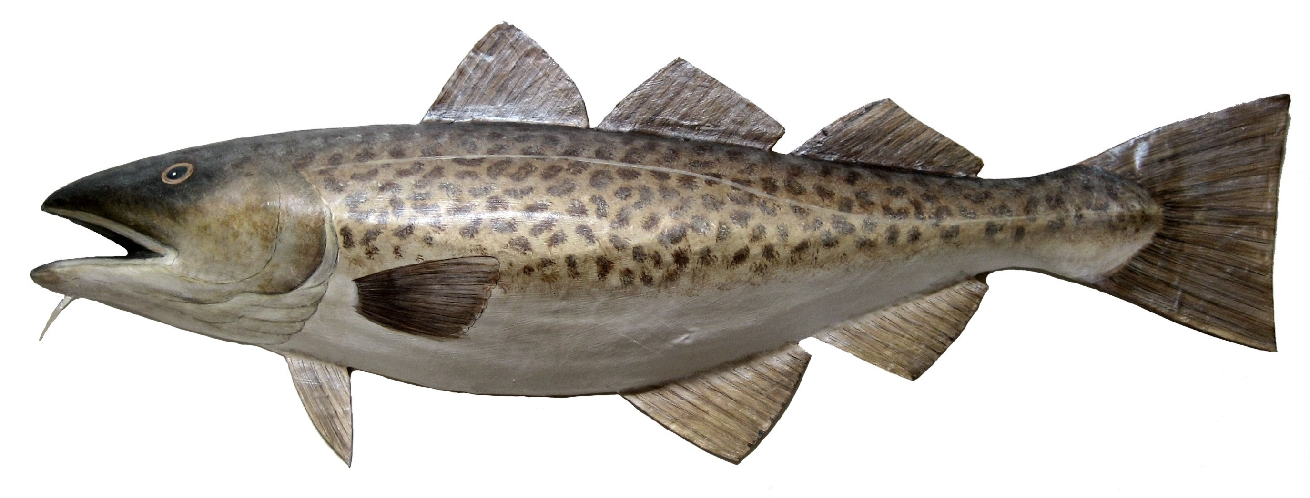

Fixing Cod Smelts
e
^
l

Slide 12
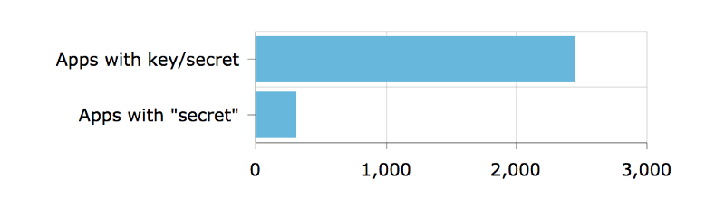
Detect security vulnerabilities
Out of 16,000 apps — apps with keys or secrets
https://hackernoon.com/we-reverse-engineered-16k-apps-heres-what-we-found-51bdf3b456bb#.eechvyizf

Slide 13
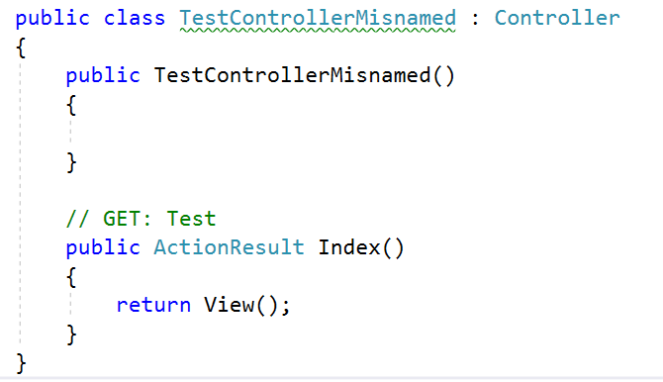
Detect domain specific errors

Slide 14

Recommend best practices

Slide 15
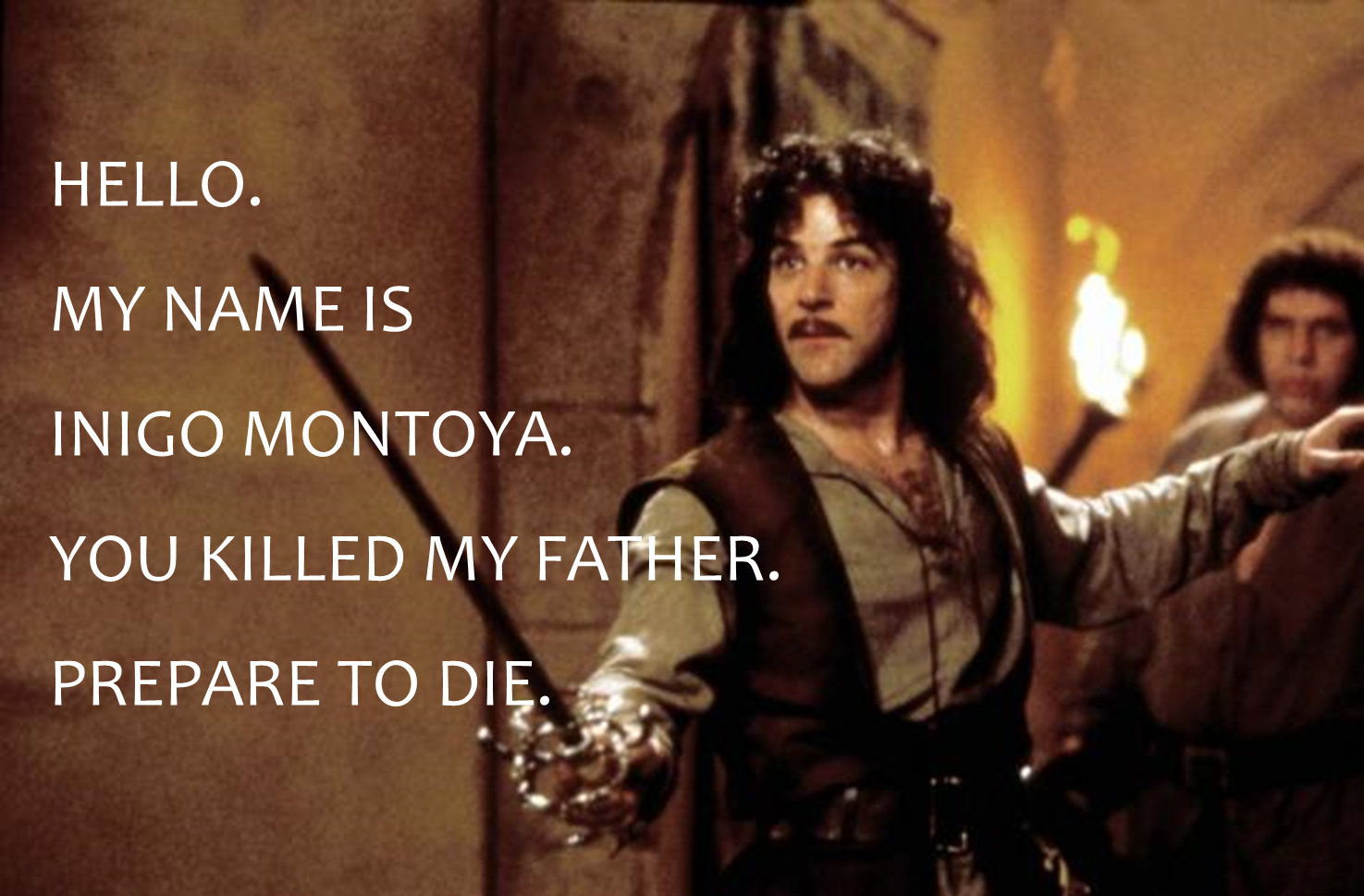
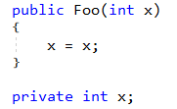
Names matter

Slide 16
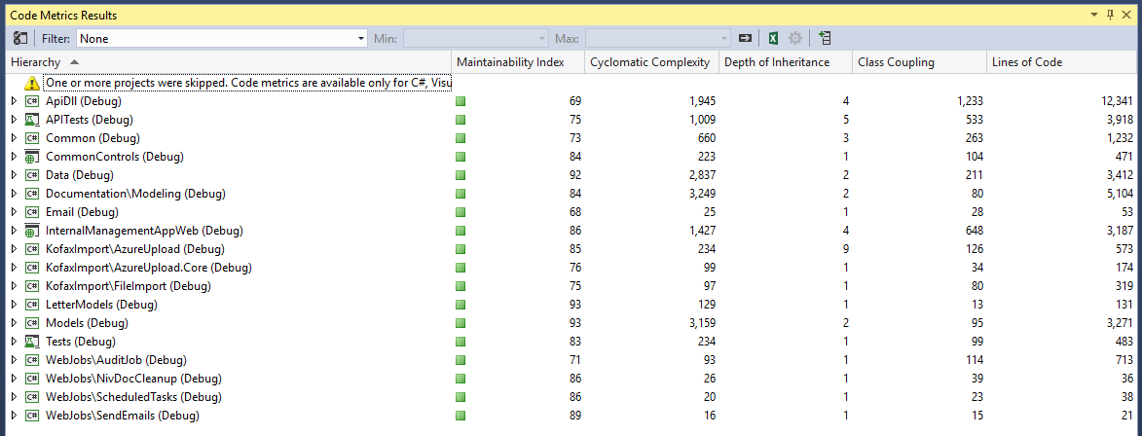
Detect maintainability issues

Slide 17
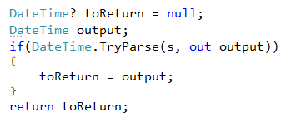
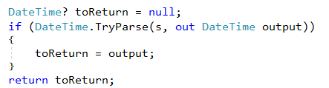
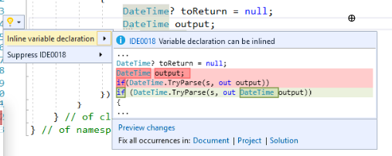
Recommend modernized syntax
Notes:
Click the icon and navigate to your photo on your computer
Crop and position photo as desired
Go to the Arrange drop down menu > choose “send to back” to reveal text

Slide 18
Tools
JsLint/JsHint
CssLint/ScssLint/PostCSS/StyleLint
SonarQube/Sonargraph/SonarLint
Roslyn/FxCop/StyleCop/Code Cracker
Code Rush/Resharper
Your favorite tool?
https://en.wikipedia.org/wiki/List_of_tools_for_static_code_analysis

Slide 19
Demo
JSLint, CSSLint, Visual Studio, Code Cracker

Slide 20
JavaScript – JsLint/JsHint

Slide 21
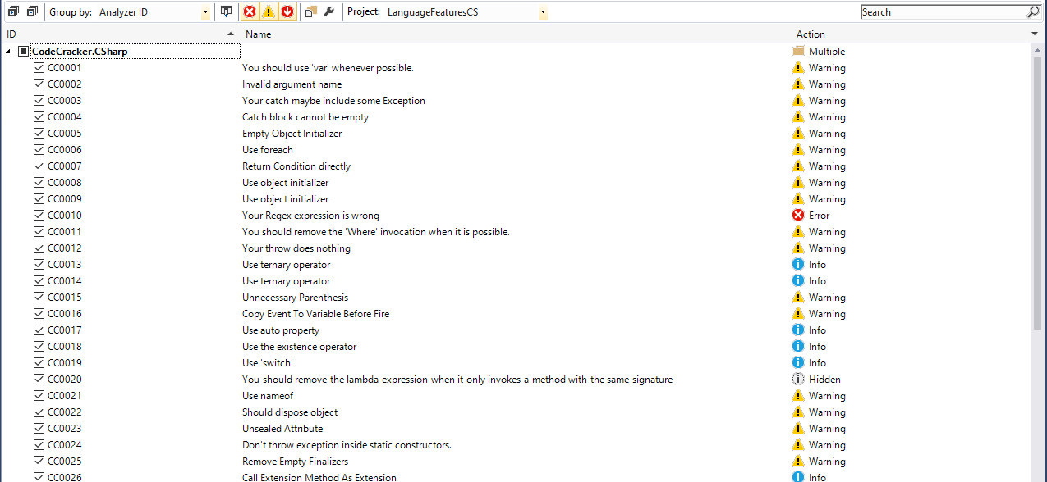
Extensible and Customizable

Slide 22
.editorconfig
[*]
end_of_line = crlf
[*.{cs,py,xmlm}]
indent_style = tab
[*.{js}]
indent_style = space
indent_size = 2
[*.cs]
dotnet_style_qualification_for_field = false:suggestion
dotnet_style_qualification_for_property = false:suggestion
dotnet_style_qualification_for_method = false:suggestion
dotnet_style_qualification_for_event = false:suggestion
dotnet_style_predefined_type_for_locals_parameters_members = true:suggestion
dotnet_style_predefined_type_for_member_access = true:suggestion
dotnet_style_object_initializer = true:suggestion
dotnet_style_collection_initializer = true:suggestion
dotnet_style_explicit_tuple_names = true:suggestion
dotnet_style_coalesce_expression = true:suggestion
dotnet_style_null_propagation = true:suggestion
csharp_style_var_for_built_in_types = true:suggestion
https://docs.microsoft.com/en-us/visualstudio/ide/editorconfig-code-style-settings-reference

Slide 23
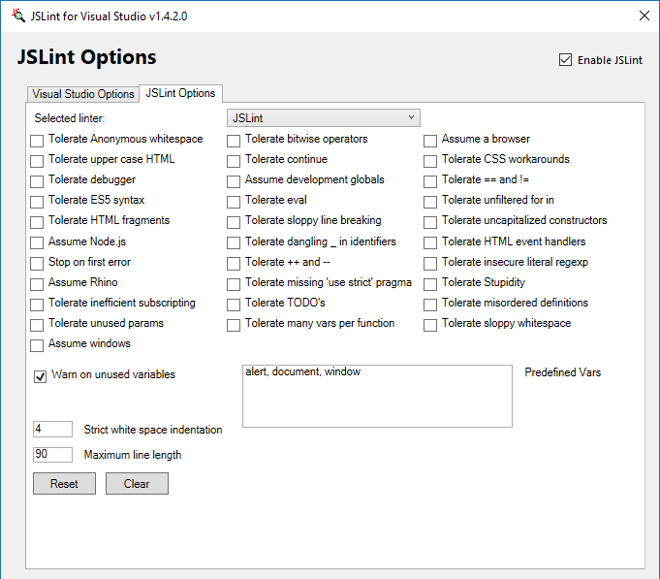
Configuring jsLint
.jshintrc
{
"undef": true,
"unused": true,
"globals": {
"MY_GLOBAL": true
}
}

Slide 24
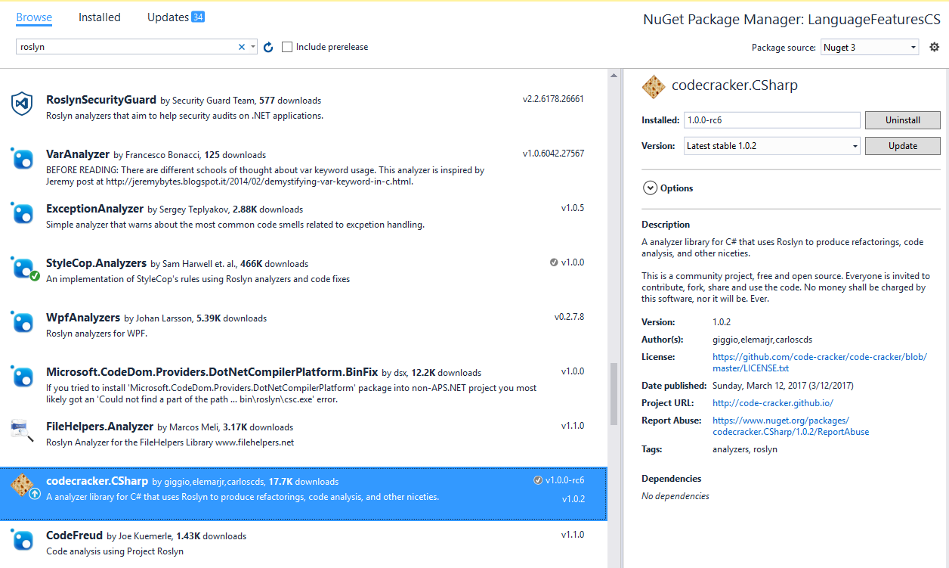
Adding Analyzer from Nuget

Slide 25
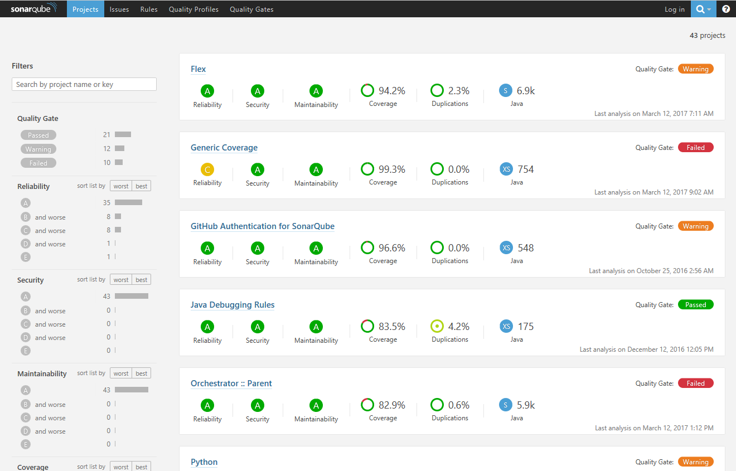
SonarQube

Slide 26
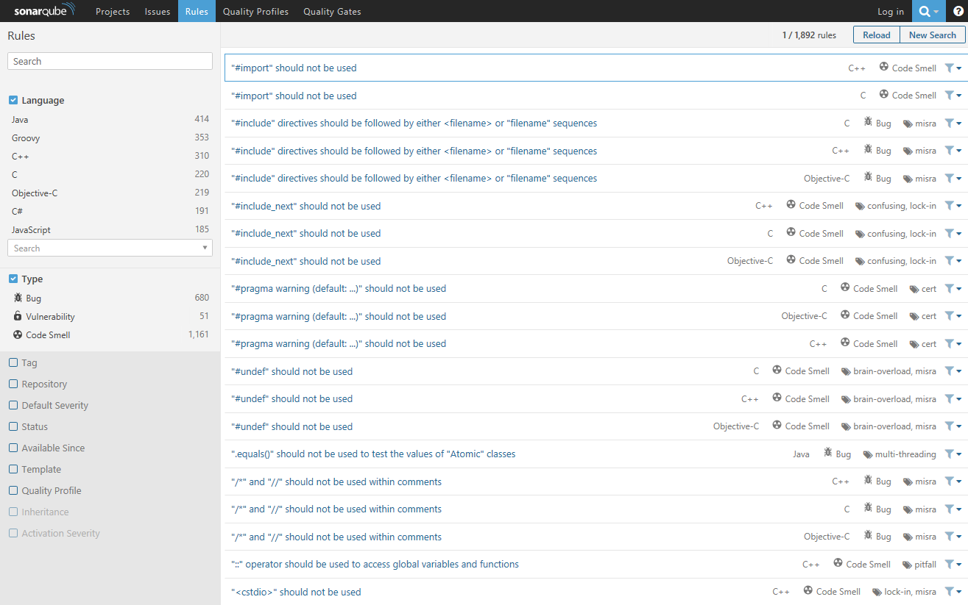
Sonar Rules

Slide 27
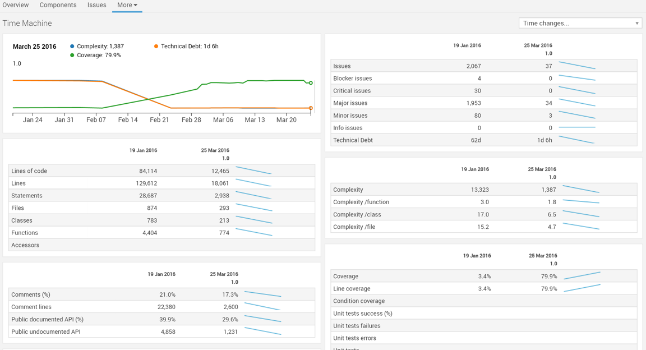
Sonar improvements

Slide 28
Detect domain specific errors

Slide 29
Creating your own Roslyn analyzer and Code Fix
[DiagnosticAnalyzer(LanguageNames.CSharp)]
public class WebApiControllerNamingConventionAnalyzer : DiagnosticAnalyzer
{
string DiagnosticId = “WA0001";
string Description = "Controller type should end in 'Controller'";
string MessageFormat = "Type name '{0}' does not end in Controller";
internal const string Category = "Naming";
private static DiagnosticDescriptor Rule = new DiagnosticDescriptor(
DiagnosticId, Description, MessageFormat, Category,
DiagnosticSeverity.Warning, true);
// Add implementation
}
private void Analyzer(SymbolAnalysisContext context)
{
var symbol = (INamedTypeSymbol)context.Symbol;
if (symbol.BaseType == null) return;
if ((symbol.BaseType.Name == "Controller"
|| symbol.BaseType.Name == "ApiController")
&& !symbol.Name.EndsWith("Controller"))
{
var diagnostic = Diagnostic.Create(
Rule, symbol.Locations[0], symbol.Name);
context.ReportDiagnostic(diagnostic);
}
}

Slide 30
Custom Diagnostic - CodeFixProvider
private async Task<Document> MakeEndInControllerAsync(
Document document,
TypeDeclarationSyntax typeDecl,
CancellationToken cancellationToken)
{
var identifierToken = typeDecl.Identifier;
var originalName = identifierToken.Text;
var nameWithoutController = Regex.Replace(
originalName, "controller", String.Empty, RegexOptions.IgnoreCase);
var newName = nameWithoutController + "Controller";
var newIdentifier = SyntaxFactory.Identifier(newName)
.WithAdditionalAnnotations(Formatter.Annotation);
var newDeclaration = typeDecl.ReplaceToken(identifierToken, newIdentifier);
var root = await document.GetSyntaxRootAsync();
var newRoot = root.ReplaceNode(typeDecl, newDeclaration);
var newDocument = document.WithSyntaxRoot(newRoot);
return newDocument;
}
[ExportCodeFixProvider("ControllerNameCodeFixProvider", LanguageNames.CSharp)]
public class ControllerNameCodeFixProvider : CodeFixProvider
{
public override ImmutableArray<string> GetFixableDiagnosticIds()
{
return ImmutableArray.Create(DiagnosticId);
}
public override async Task ComputeFixesAsync(CodeFixContext context)
{
var root = await context.Document.GetSyntaxRootAsync(
context.CancellationToken).ConfigureAwait(false);
var diagnostic = context.Diagnostics.First();
var diagnosticSpan = diagnostic.Location.SourceSpan;
var declaration = root.FindToken(diagnosticSpan.Start)
.Parent.AncestorsAndSelf()
.OfType<TypeDeclarationSyntax>().First();
context.RegisterFix(
CodeAction.Create("Ensure type ends in 'Controller'",
c => MakeEndInControllerAsync(context.Document, declaration, c)),
diagnostic );
}

Slide 31
Create ESLint rule
module.exports = {
meta: {
docs: {
description: "disallow unnecessary semicolons",
category: "Possible Errors",
recommended: true
},
fixable: "code",
schema: [] // no options
},
create: function(context) {
return {
// callback functionshttp://eslint.org/docs/developer-guide/working-with-rules
};
}
};
http://eslint.org/docs/developer-guide/working-with-rules

Slide 32
Key Principals
Start Early
Run Often
Customize for your needs
Augment SDLC
Focus Code Review on domain issues not code smells

Slide 33

“The key takeaway is to use the tools available to find any defect you can – for even if you don’t, your adversaries will.”
- Travis Smith
Notes:
Follow up questions: What are you going to be proud of when you put your head to pillow at the end of 2017? What are you worried might not get to the finish line?

Slide 34
Q & A
https://jwooley.github.io
http://www.thinqlinq.com
http://www.twitter.com/jimwooley
slalom.com
Notes:
Click the icon and navigate to your photo on your computer
Crop and position photo as desired
Go to the Arrange drop down menu > choose “send to back” to reveal text

Slide 35
About Jim
Solultion Architect
Microsoft MVP
Slalom Consulting
Visual Studio Tools
03
Author
@JimWooley
LINQ in Action
https://github.com/jwooley/Analyzers
http://www.thinqlinq.com
Notes:
Click the icon and navigate to your photo on your computer
Crop and position photo as desired
Go to the Arrange drop down menu > choose “send to back” to reveal text

